Slide 1

The Elemental Palace
A game by
A wizard ventures into an old palace in search of a magic tome containing elemental power, but when he arrives, he finds the tower overrun by strange creatures and dangers.

Slide 2
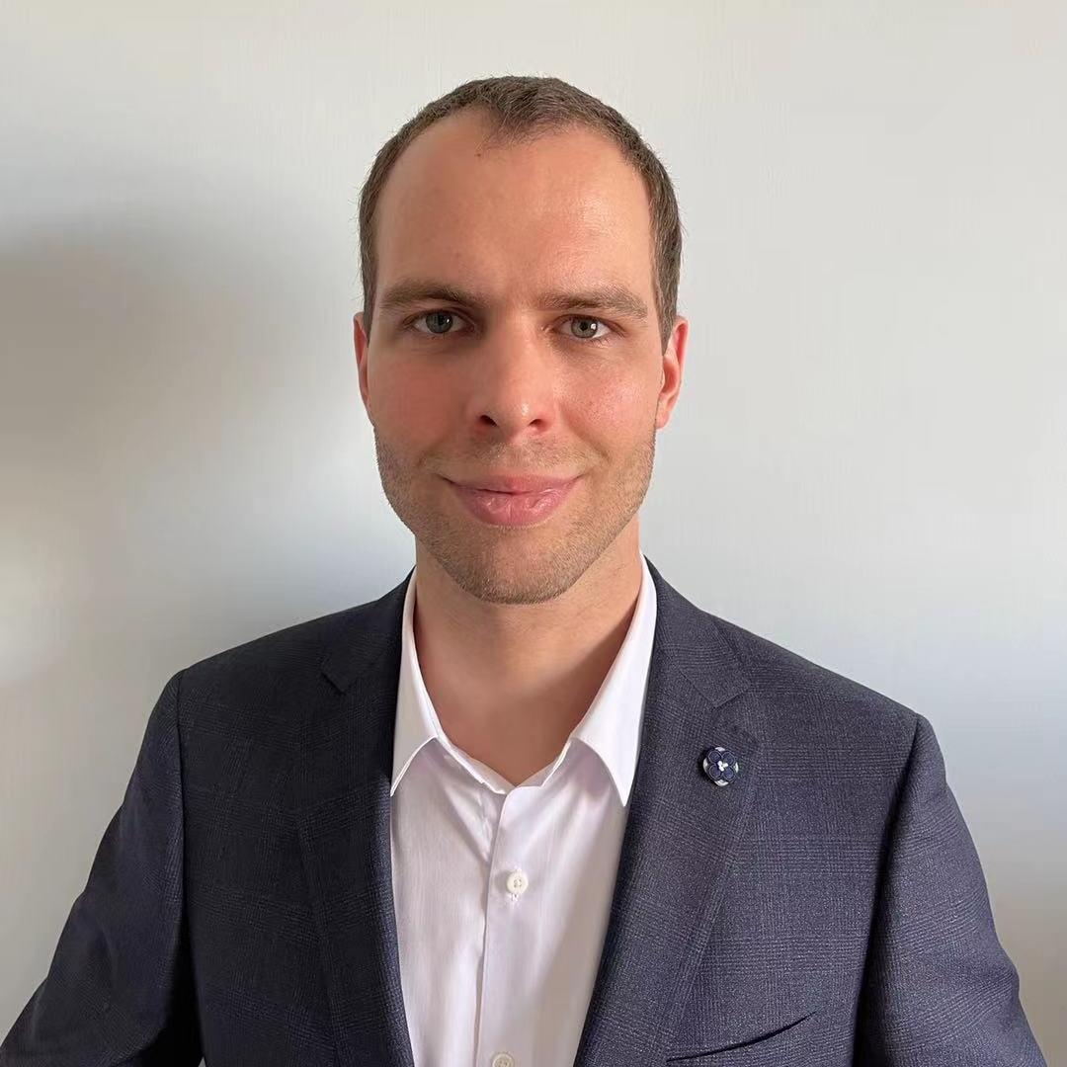


The Team
Daniel Ben Zvi
Character Movement
Artificial Intelligence
User Interface
Team Lead
William Terlop
Character Abilities
Item System and Inventory
Cutscenes and Cinematics
Team Lead
Marcos A. Camacho
Level Design
Gameplay Progression
Gameplay Balancing
Creative Director

Slide 3
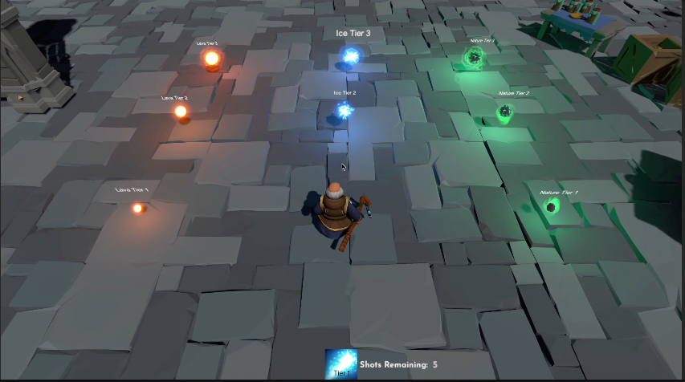
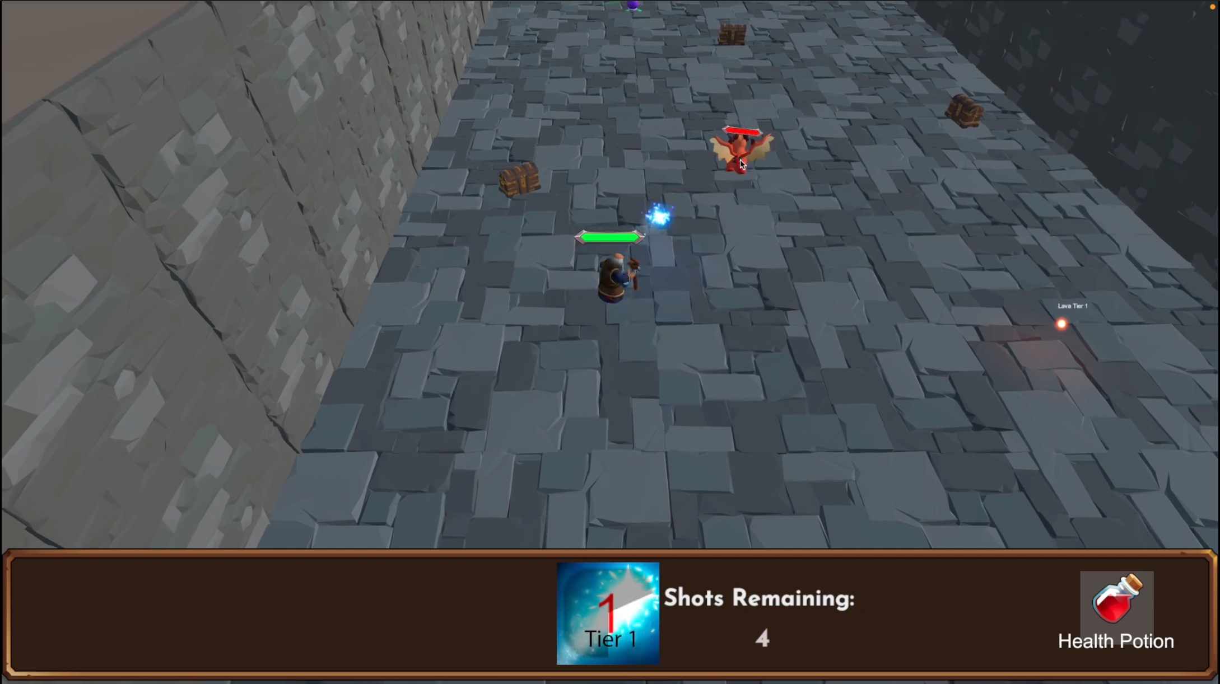
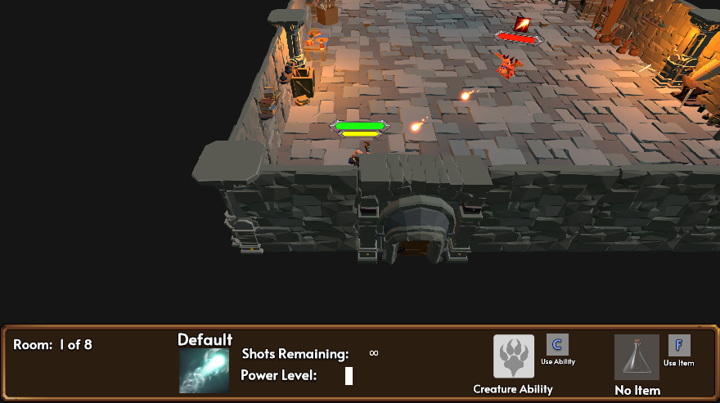
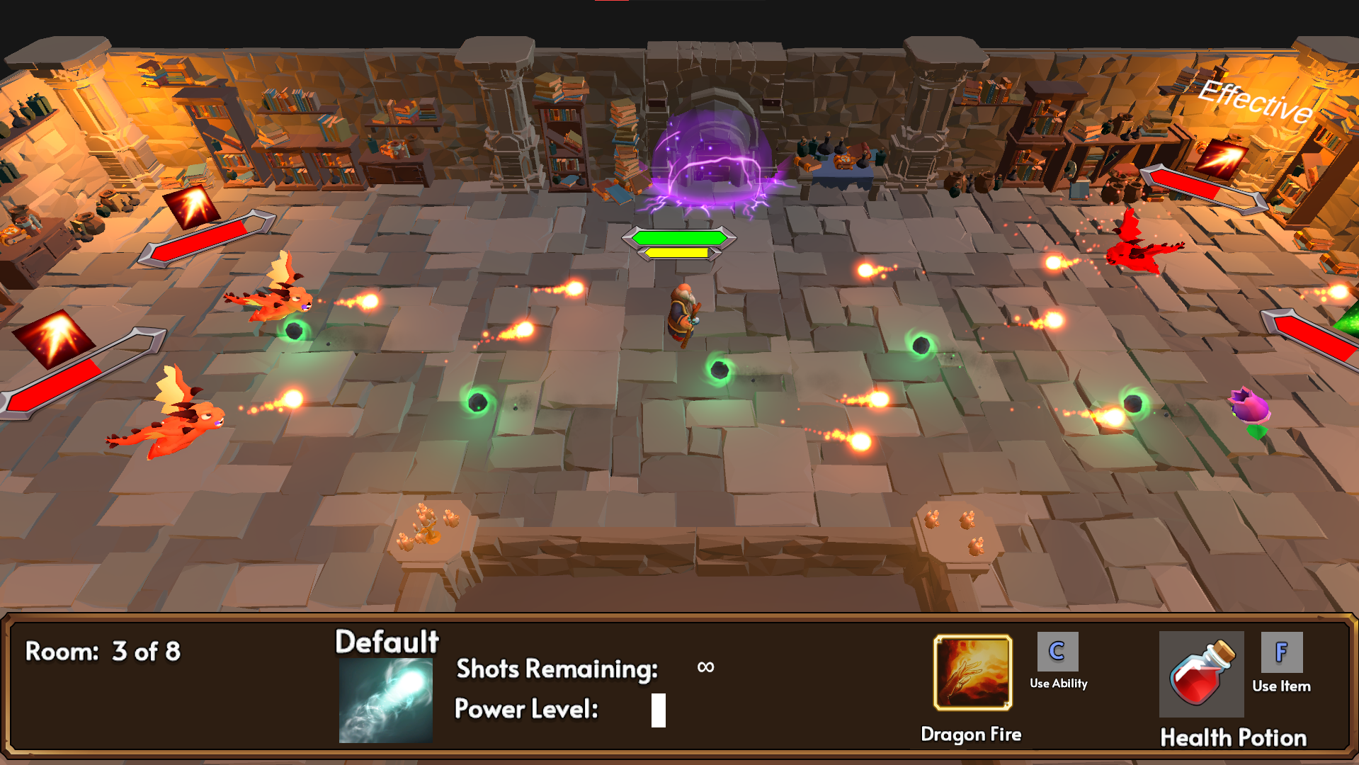
Progress
Prototype
Alpha
First Playable
Final
Notes:
Prototype = PP2 first milestone
First Playable = PP2 final milestone
Alpha = PP3 alpha milestone
Final = Game today

Slide 4
Tips/Tricks
Advice Learned
Keep scope creep in check! There were multiple times we unknowingly found ourself adding new features and working on things that we didn’t originally plan.
Beware of Crunch
All of our team members ended up working much much longer on the project than we forecasted. This was due to various factors including work/life balance, and the above scope creep.
Assign work on strengths and interests
In our group we worked very well together. We each had our strengths on the project and let each other take on tasks we specialized in. This allowed each aspect to be as polished as possible.
Review Peer Teamwork
Set a time for peer review of team member work. This will help ensure quality ahead of time and help the work be more integrated into the work.

Slide 5

What Went Right
Team members all agreed on game idea
Each team member had unique strengths
This worked out perfectly for us as it allowed us each a space to work without many conflicting aspects. It also allowed us to each learn from each other and gain new skills.
We each got a chance to learn new things
This was great because despite having our strengths going into the project, we each got a chance to branch out into new areas of expertise. We learned new things like Artificial Intelligence, Cinemachine, and UI Design.
We completed a full game!
This is awesome! It seems self-explanatory however, I don’t think any of us have a completed game in our portfolio. Cutscenes, 8 action packed levels, power-ups, abilities, story.. Our game has it all. Its an amazing accomplishment that we all made happen.
This was great because we all shared a similar vision for the game. We had a few ideas for games which we all liked, but we all quickly were able to agree on the one we were going to work on. This allowed us to quickly start designing and communicating.

Slide 6
What Went Wrong
We lost team members
We had unresponsive and unproductive members
It was difficult when we lost a team member who was with us since the beginning. We had a new team member who came to our team with the promise of wanting to do good work. The member quickly became unresponsive to us and delivered poor quality work.
Scope creep
This is something you hear about all the time, but it was a real thing on this project. It happened without us knowing. There would be things we said we needed to “fix” that ended up being new features and it really hurt us on the project.
Version Control Issues
There were A LOT of merge conflicts on this project. This was probably the first time many of the team used a VCS. We were even working in separate areas of the code. We really ran into issues when our work started overlapping. Commit often is the best way to prevent this.
At the beginning of this class, we lost the only person on our team who knew how to script AI. We weren’t sure how this was going to affect our group. Luckily, Daniel was able to quickly pickup and learn how to take over this job and deliver a great experience.

